Slide 1
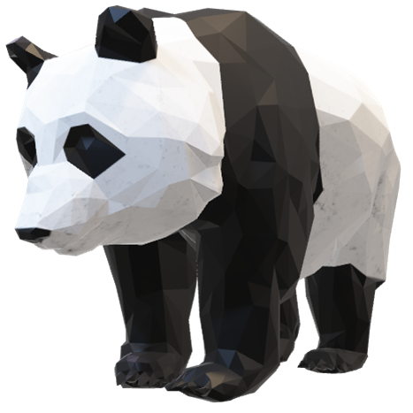
3D loading app

Slide 2
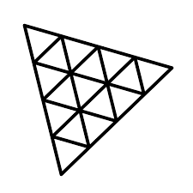


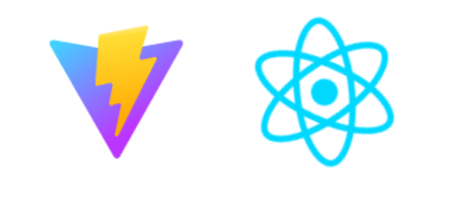
Realisatie
React.js + vite
Three.js
Blender
Electron.js

Slide 3
Planning
Onderzoek, Blender
Blender, UI design, Basis in Electron
UI design, maken applicatie

